Slide 1
ADVERTISEMENTS
WHAT ARE ADVERTISEMENTS?
WHY ARE THEY REQUIRED?
WHAT IS THEIR PURPOSE?
WHAT IS A ‘BRAND’?
STATE AN ADVERTISEMENT THAT HAS INFLUENCED YOUR PARENTS TO BUY A PRODUCT?

Slide 2


Types of ADVERTISEMENTS-SOCIAL

Slide 3
TAKE OUT 10 AMUL ADVERTISEMENTS.
5 THAT ARE PURELY COMMERCIAL AND
5 THAT ARE SOCIAL ADVERTISEMENTS.
TO DO

Slide 4


COMMERCIAL

Slide 5

EVERYDAY ADVERTISEMENTS

Slide 6
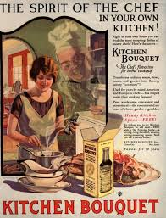

Slide 7
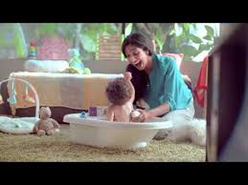

Slide 8


Slide 9


Slide 10
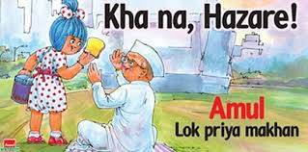

Slide 11


